Slide 1

Multi process system monitor
Abhishek Shah
24NAG1279_U02

Slide 2
Introduction
Project Goal:
To create a system, monitor that track and reports the status of multiple system processes.

Slide 3
Why This Project?
Understand multi-process management
Learn inter-process communication (IPC) techniques
Gain experience in system monitoring and performance tracking

Slide 4
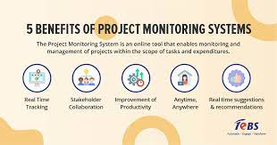

Slide 5
Components
Central Monitoring Process: Manages child processes and collects data.
Child Processes: Perform specific monitoring tasks.
Inter-Process Communication (IPC): Uses pipes to communicate between processes.
System Information Gathering: Uses /proc filesystem to fetch process data.

Slide 6
Header File
Purpose:
Define constants, function prototypes, and IPC mechanisms.

Slide 7
Key Elements:
Constants: NUM_CHILD_PROCESSES, BUFFER_SIZE
Function Prototypes: start_monitoring(), handle_child_process()
Global Variables: IPC-related variables

Slide 8
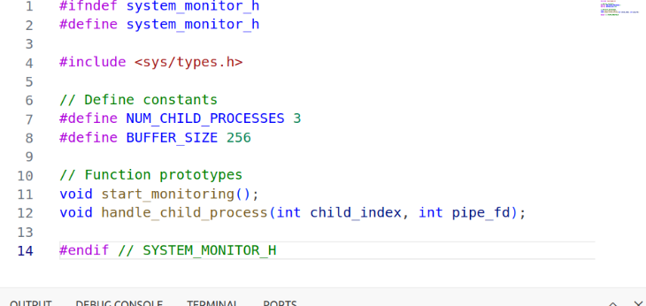

Slide 9
Monitor Process
Purpose:
Manage child processes and handle IPC

Slide 10
Main Functions:
Creating Pipes: Set up communication channels.
Forking Processes: Create child processes for monitoring.
Reading Data: Collect and print data from child processes.
Waiting for Completion: Ensure all child processes finish before exiting.

Slide 11
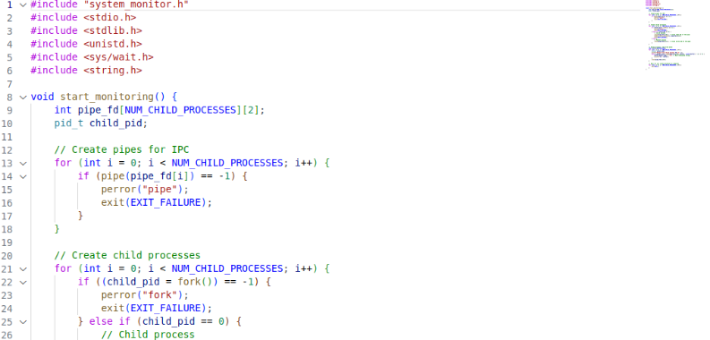

Slide 12
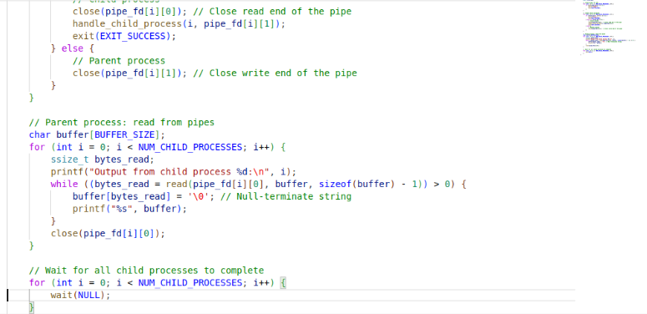

Slide 13
Child Processes
Purpose:
Perform specific monitoring tasks in child processes.

Slide 14
Main Functions
Reading System Information: Access /proc files or similar sources.
Writing to Pipe: Send collected data back to the parent process.

Slide 15
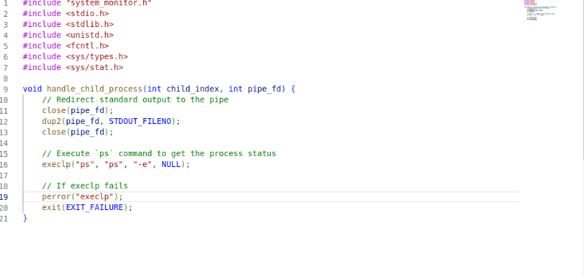

Slide 16
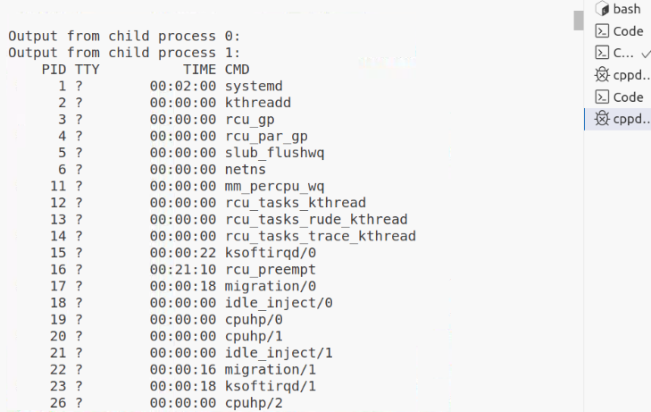
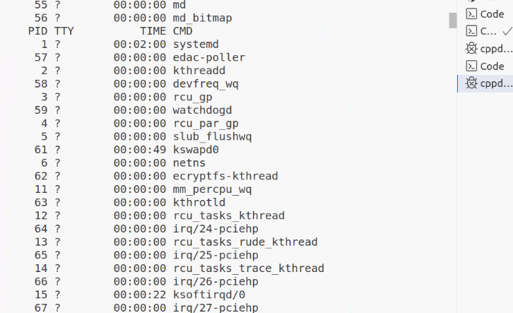
Output

Slide 17
Challenges:
Process Synchronization: Ensuring accurate and synchronized data collection.
IPC Handling: Efficiently managing inter-process communication.
Error Handling: Dealing with file access errors and process management issues.

Slide 18
Solutions:
Mutexes and Semaphores: Use for synchronization (if needed).
Robust Error Checking: Implement comprehensive error handling.

Slide 19
Future Improvements
Enhanced Monitoring:
CPU and Memory Usage: Implement more detailed tracking.
Additional Metrics: Include network usage, disk I/O, etc.

Slide 20
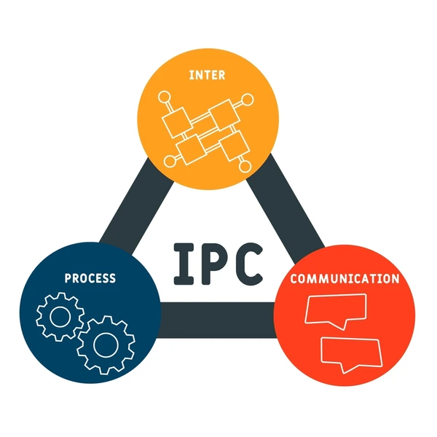

Slide 21
Improved IPC Mechanisms:
Message Queues: For more complex communication needs.
Shared Memory: For higher performance data sharing

Slide 22
User Interface:
GUI: Create a graphical interface for better usability

Slide 23
Thank You

